Slide 1

COMP 490/L Senior Design Project Fall 2022 490/L Project Presentation
Group Name: White Volley Girls
Team Leader: Christian Jarmon

Slide 2
Agenda
Project Overview
Problem Definition
Application Samples
Software overview diagram and explanation
Sample Code Snippets
App Demo
Progress and Future Work
Questions

Slide 3
Project Overview
A web-based set of tools and utilities for CSUN students and advisors to effectively plan and explore classes, schedules, professors, and majors provided by the university.

Slide 4
Problem Definition
Our goal was to gather, defragment, and organize all the information of catalogs, professors, majors, and school rules/guidelines.
Allows any and all to effectively plan one’s journey traversing CSUN.

Slide 5
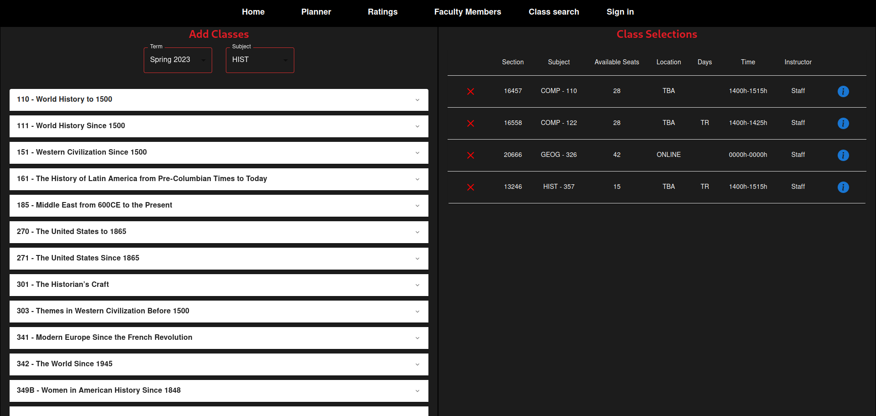
Application screenshots

Slide 6
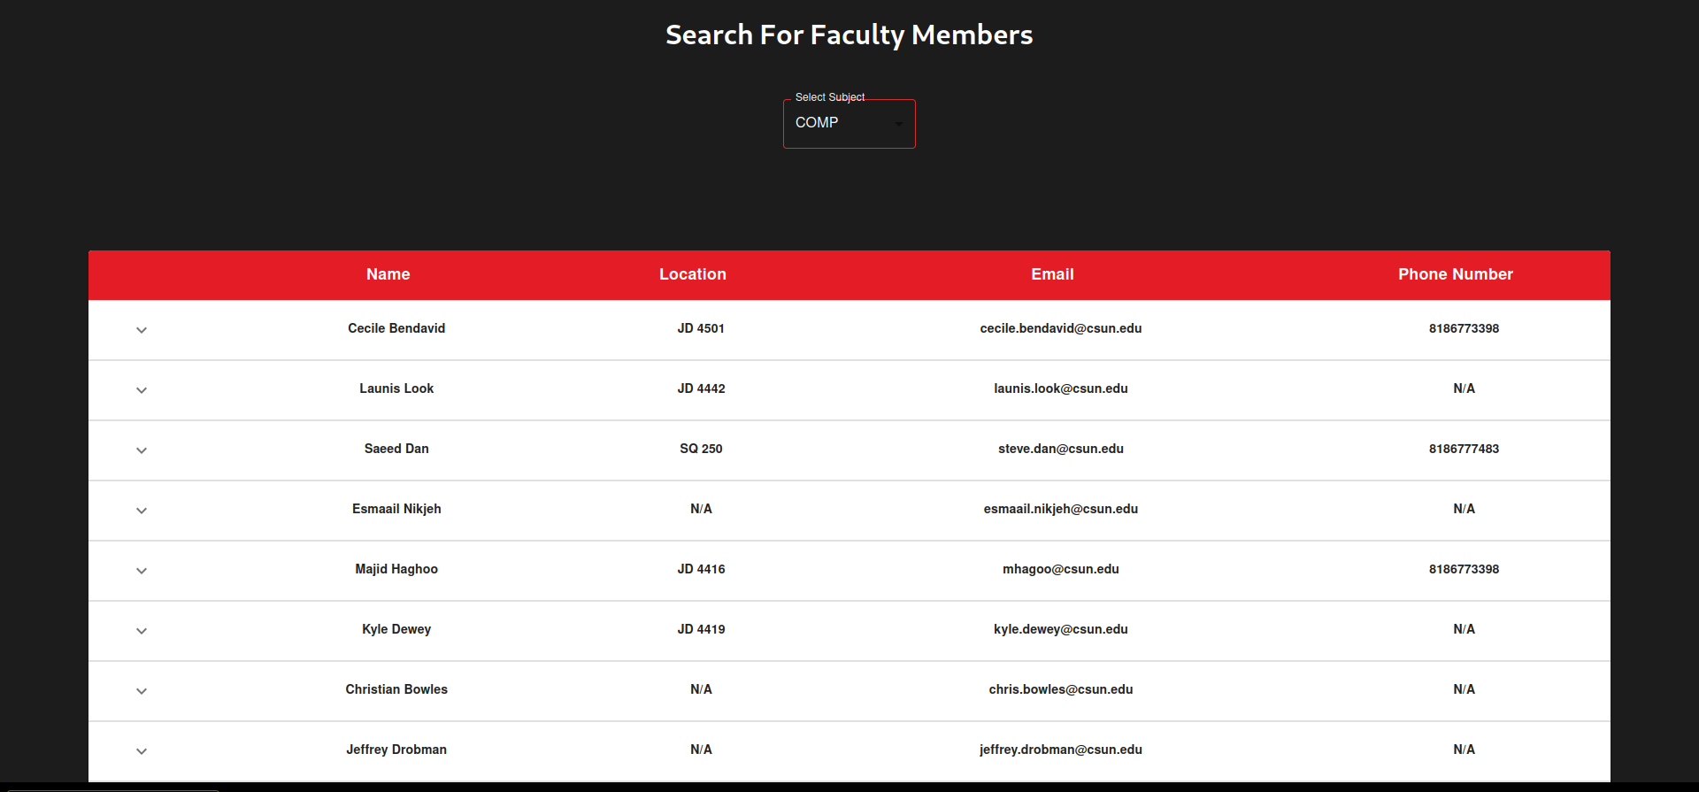
Application screenshots

Slide 7
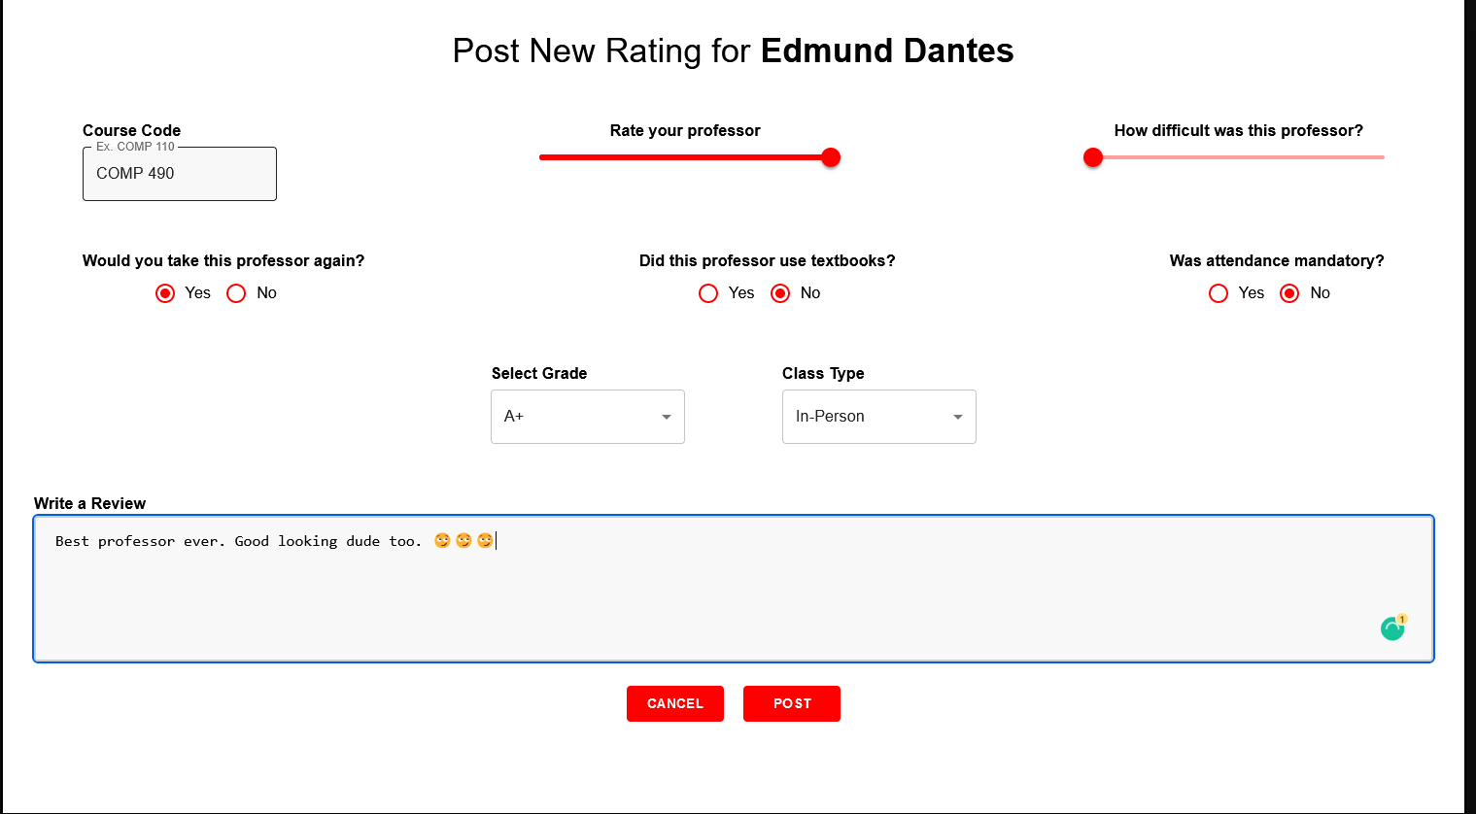
Application screenshots

Slide 8
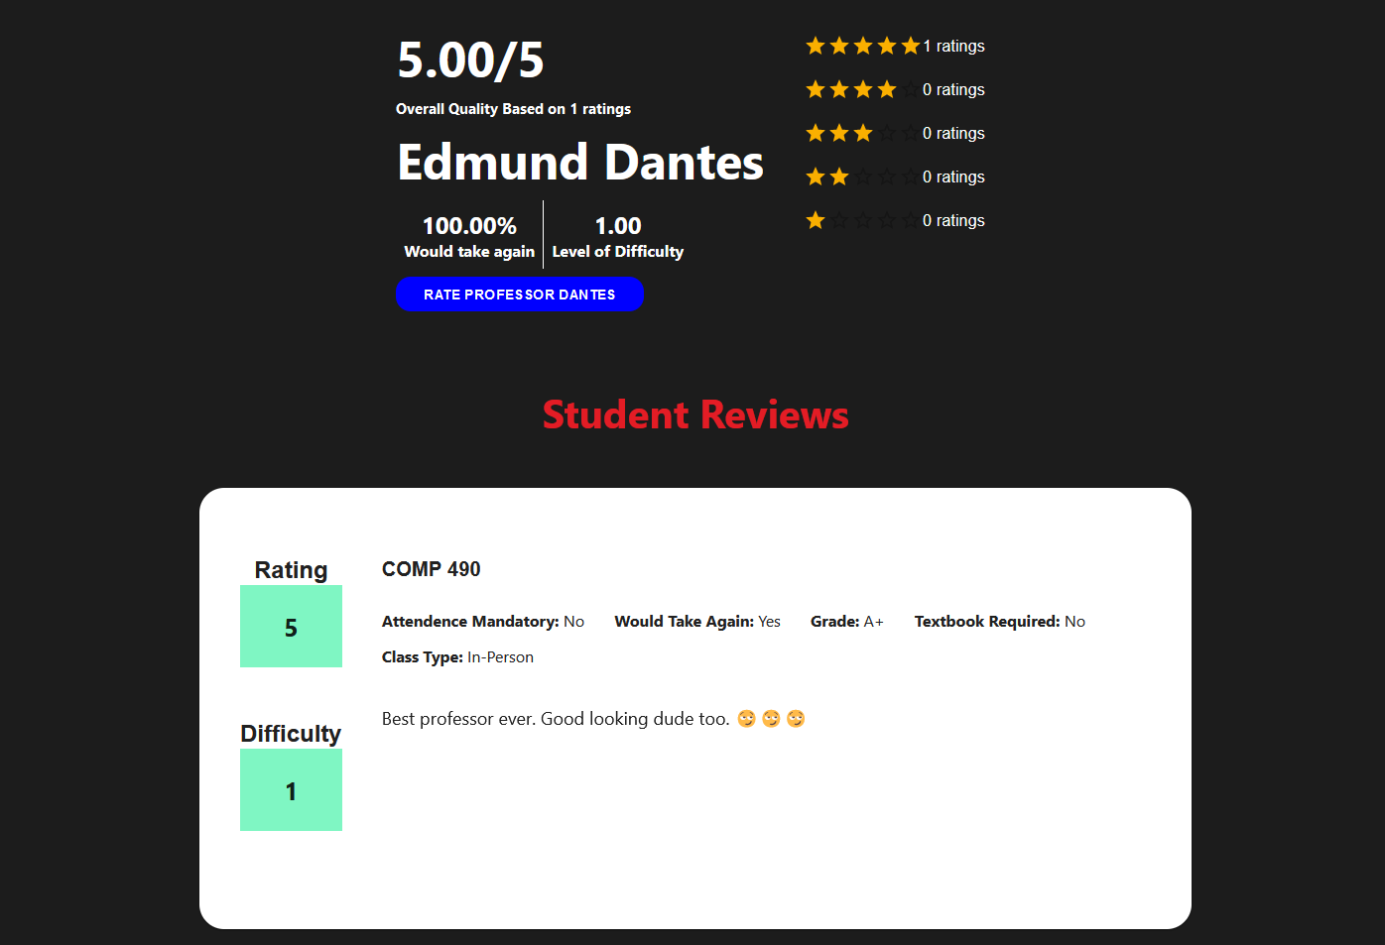
Application screenshots

Slide 9
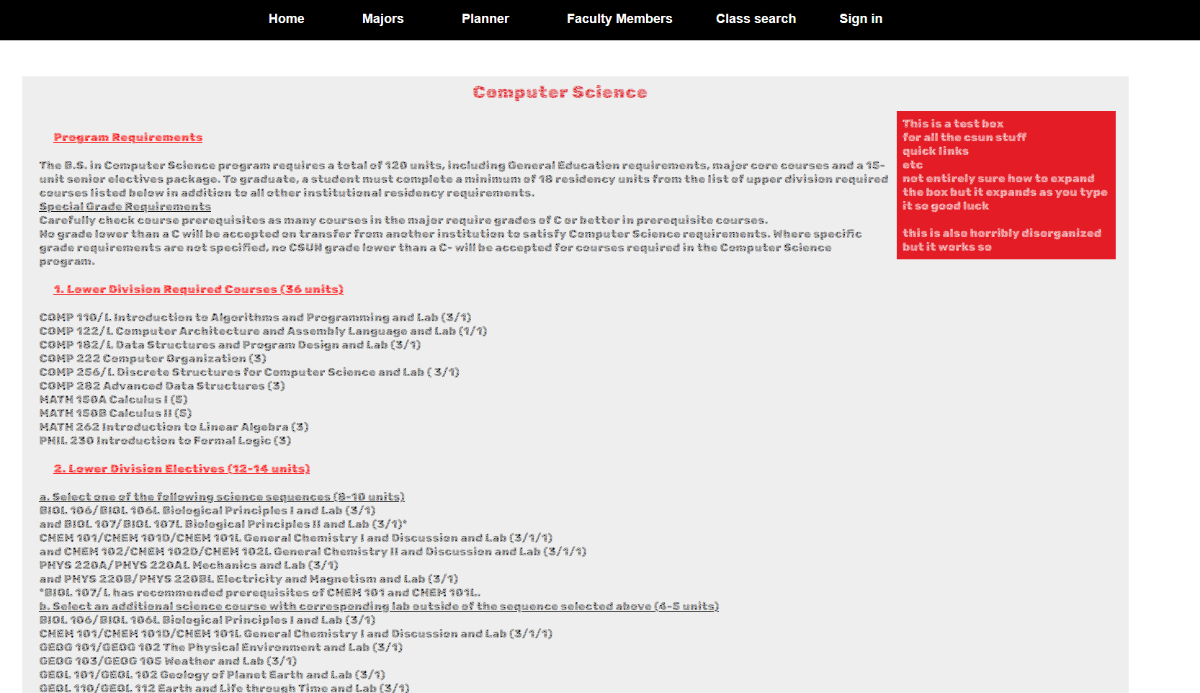
Application screenshots

Slide 10
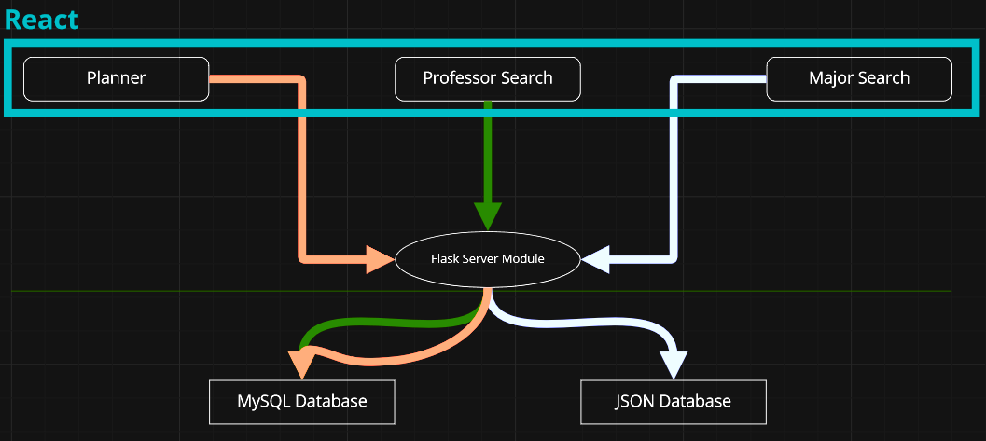
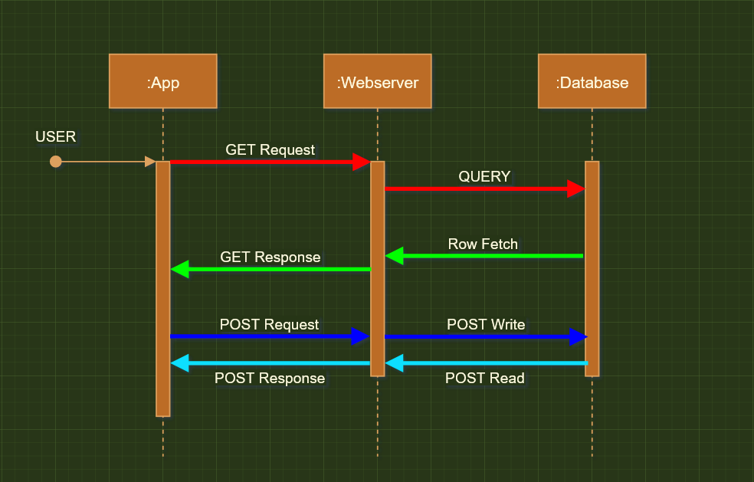
Software Overview
<= Components
Sequence Diagram =>

Slide 11
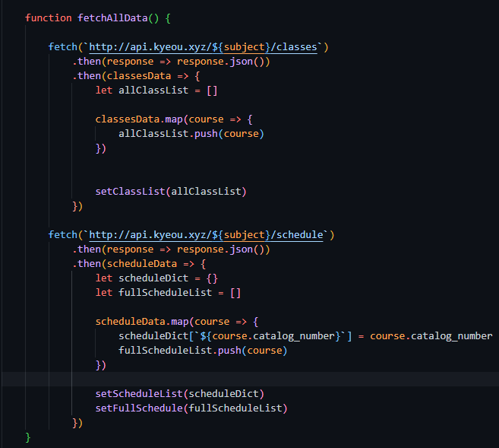
Notes:
Michael

Slide 12
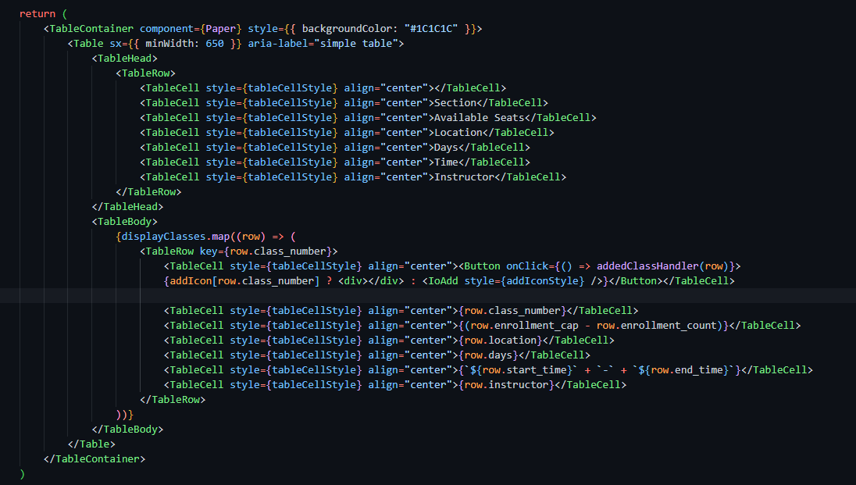
Notes:
Michael

Slide 13
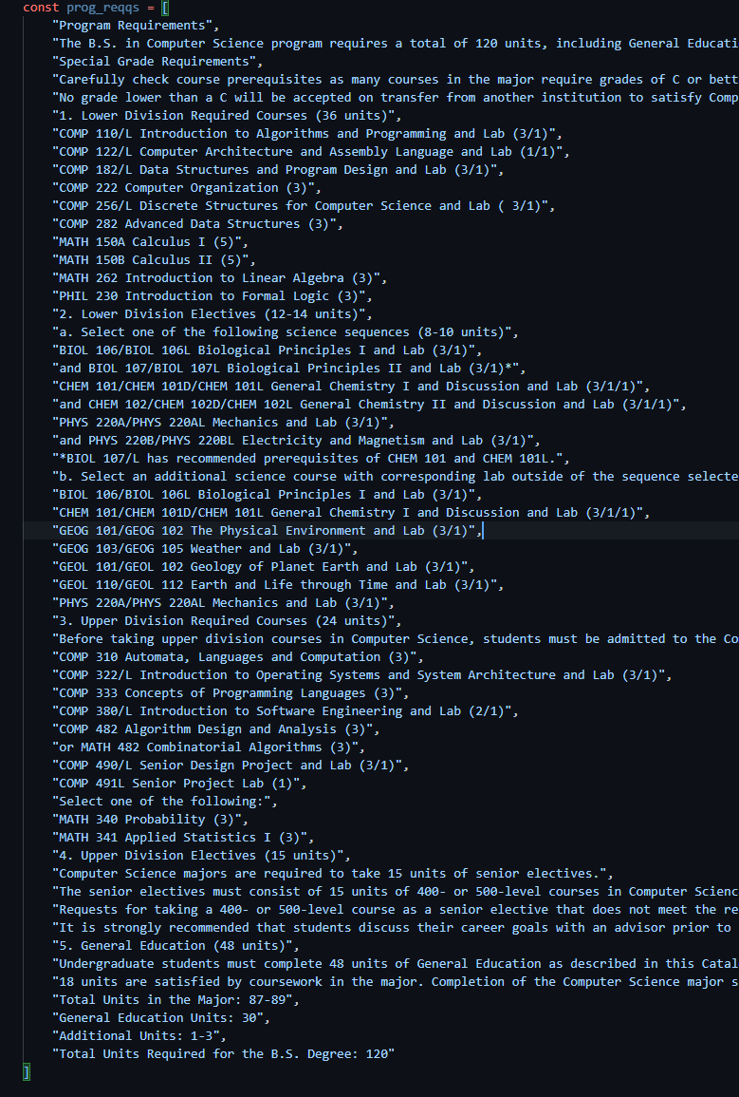
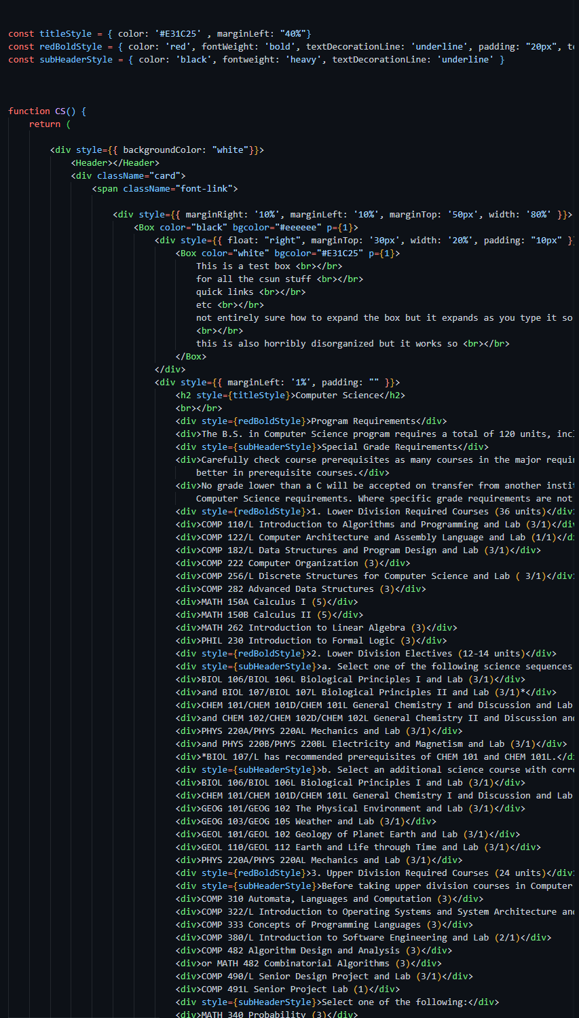
Notes:
David

Slide 14
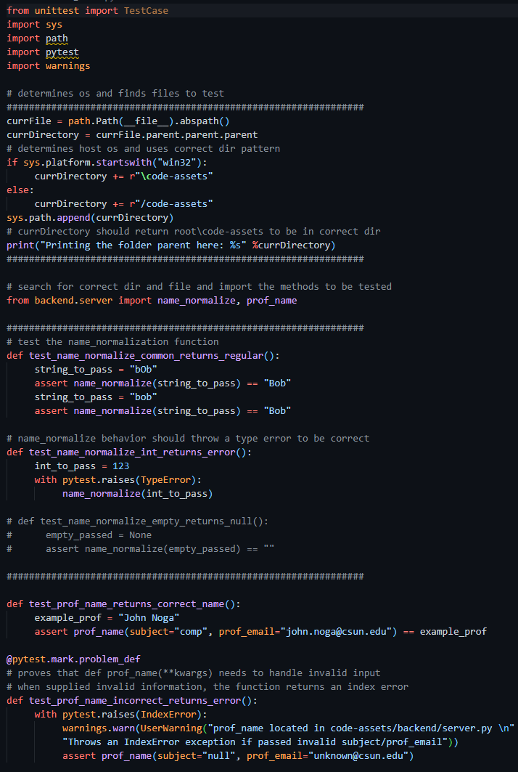
Notes:
Nima

Slide 15
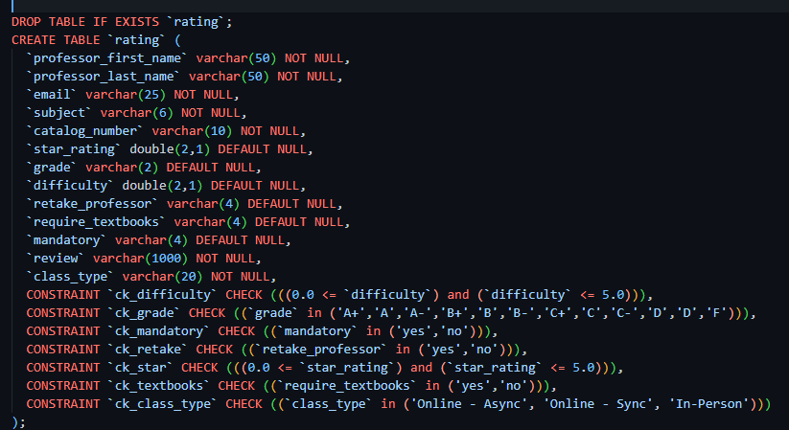
Notes:
Christian

Slide 16
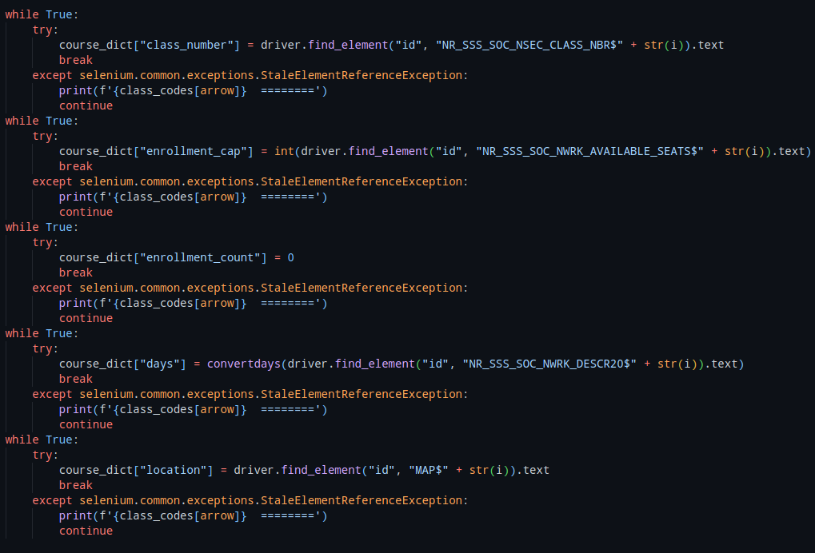
Notes:
Christian

Slide 17
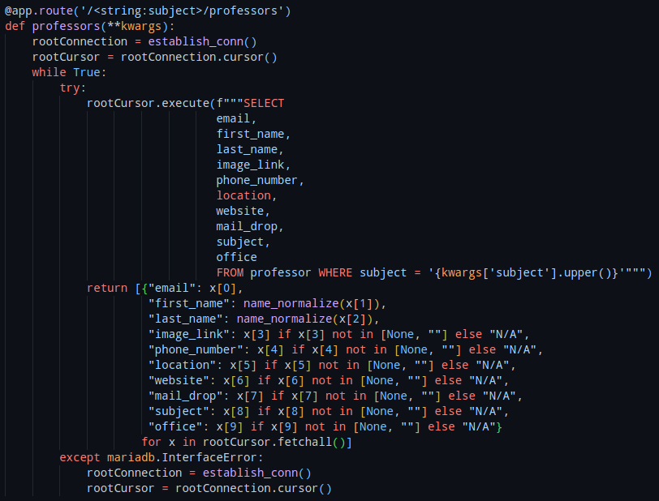
Sample Code Snippets
Notes:
Christian

Slide 18
App Demo

Slide 19
Progress and Future Work
Features
Add ability to make Accounts
Allow saving of planned schedules
Allow user to input already taken classes.
Automated planning feature using AI.
Will be based on user’s academic preference and performance of previous classes
Technical Stuffs
Implement frontend routing with NodeJS
For back and forward navigation between pages
UI/UX
Make it pretty.

Slide 20

Questions?

